Slide 1
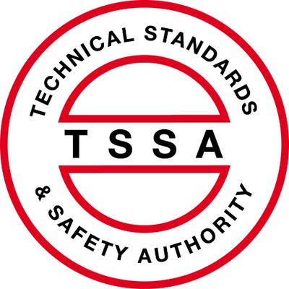
TSSA’s Operating Engineers Safety Program
Overview of Path 2
Risk & Safety Management Plans

Slide 2
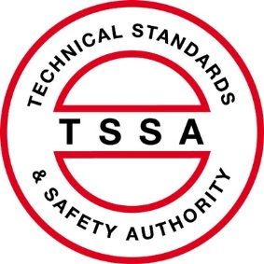
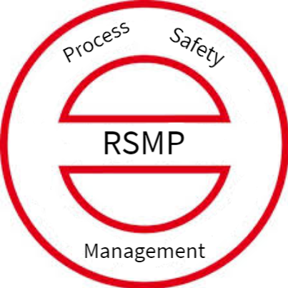
Current Regulation: Staffing Based on kW
New Regulation
Path 1
Staffing Based On:
power
technology
pressure, temperature
flammability
toxicity
public exposure
Path 2
No Staffing Prescription, per se
requires site-specific
Risk and Safety
Management Plan

Slide 3
Path 2 RSMP
RSMP to be based upon CSA Z767 Process Safety Management standard.
RSMP to be submitted to TSSA.
RSMP to be reviewed and accepted by TSSA.
Acceptance of RSMP based in large party upon the plant’s risk assessment of the worst case scenario that considers the following parameters:
pressure, temperature and inherent stored energy
technology
use of flammable or toxic materials
public exposure.

Slide 4
CSA-Z767-17 Process Safety Management Pillars and Elements
Process Safety Leadership | Understanding Hazards and Risks | Risk Management | Review and Improvement
Accountability | Process knowledge and documentation | Training and competency | Investigation
Regulations, codes and standards | Project review and design procedures | MOC | Audits process
Process safety culture | Process risk assessment and risk reduction | Process and equipment integrity | Enhancement of process safety knowledge
Conduct of operations – senior management responsibility | Human Factors | Emergency management planning | Key performance indicators

Slide 5
CSA-Z767-17 Examples of Process Safety Information Required
Drawings | P&IDs Area electrical classification Safety plot plan with fire protection equipment Flame and flammable gas detection layout Toxic gas detection Cause and effects diagrams and logic narratives Ventilation and systems design
Data Sheets | Instrument data sheets Mechanical safety systems: PSV, hardwired trips, and guards
Lists | Line designation table Equipment lists Valve locking lists Designation of process safety-critical equipment Process interlocks
Standards and Codes | Design codes and standards employed SIS and SIF (safety requirements specification) Overpressure protection by system design information
Reports | Materials of construction and their suitability in handling process materials Corrosion hazard review reports Material selection diagram Incidents and near misses
Other | Emergency shutdown device design basis, valve list and test records SIF (part of SIS) test records Instrument grounding arrangement diagrams Corrosion allowance Data regarding ventilation system design Process control systems Critical alarms, systems, etc.

Slide 6
CSA Definitions of Interest
Process safety culture – the attitudes, values, norms, beliefs and behaviors that a particular group of people share with respect to risk and safety.
Note: the essence of a positive culture is to bring continuous, positive improvements to process safety through a PSM program.
Safety Instrumented system – a distinct reliable system used to safeguard a process to prevent a catastrophic release of toxic, flammable or explosive chemicals [IEC 61508-1].
Note: a SIS loop is a system composed of sensors, logic solvers, and final control elements for the purpose of taking a process to a safe state, when predetermined conditions are violated [Adopted from: ISA S84.00.01].
Shutdown key – a specialized table presenting process deviations (or causes) in rows and a set of process responses (or effects) in columns.
Note: the intersection cell in the matrix defines relationship between the cause and the effect.

Slide 7
CSA Definitions of Interest Cont.
Worst credible scenario – the event scenario which has the highest consequence, and which is reasonably plausible in comparison with the facility risk threshold.
Human factors – the design and evaluation of tasks, jobs, environments, and systems to optimize them with human wellbeing performance.
Note: it is intended to ensure work environments are compatible with human needs and limits and abilities.

Slide 8
How to Achieve TSSA Path 2 RSMP Compliance
Figure out the CSA Z767 Standard
Assemble the Information
Institute the Required PSM Policies
Do the Risk Assessment
Prepare the Necessary Procedures
Put All of the Above Into the RSMP
Conduct Staff Orientation and Training
Submit the RSMP to TSSA
Review and Discussion
Acceptance by TSSA

Slide 9
PSM Policies
Overall PSM Policy
Conduct of Operations Policy
Maintenance, Inspection and Testing Policies
New Project and Management of Change Policies
Training and Competency Policy
Incident Reporting and Investigation Policies
Key Performance Indicators
Audit Policy

Slide 10
Risk Assessment
Likelihood and Impacts
Determine Impact on Public (Injury or Death)
Risk Register
Selection and Modelling of Worst Case Scenario
Consider Measures to Cost-Effectively Reduce Risk
If Any Cost-Effective Measures: Plan, Schedule, Install, Monitor These
Redo Risk Assessment Every 5 Years (unless New Project or Material Change)
Consider Effect of On- Site Staff
Consider Effect of Engineering Controls
Consider Effect of On- Site Staff
Consider Effect of On- Site Staff
Consider Effect of Engineering Controls
Consider Effect of Engineering Controls

Slide 11
Procedures
Conduct of Operations
Maintenance, Inspection and Testing
New Projects and Management of Change
Training
Emergency Response
Incident Reporting and Investigation
Audit

Slide 12
Example RSMP Table of Contents
Process Safety Management Policies
Information (referenced to document system)
Results of Risk and Human Factors Assessment (report appended)
Procedures (appended)
Training and Staffing
Culture and Continuous Improvement
Appendices
Risk assessment
Procedures
Training Plan and Log

Slide 13
TSSA Acceptability Distinctions
By Material
By Other Factors
High pressure steam
Low pressure steam or hot water
Natural gas
Fuel oil
Chlorine (or other water treatment)
Ammonia
Flammable refrigerants
Other hazardous material
Safety Instrumented System
Automatic shutdown key
Exposure to public from worst case

