Slide 1
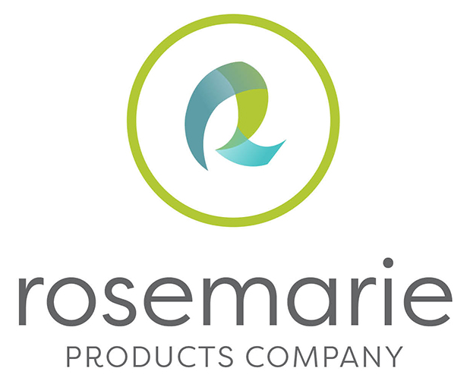

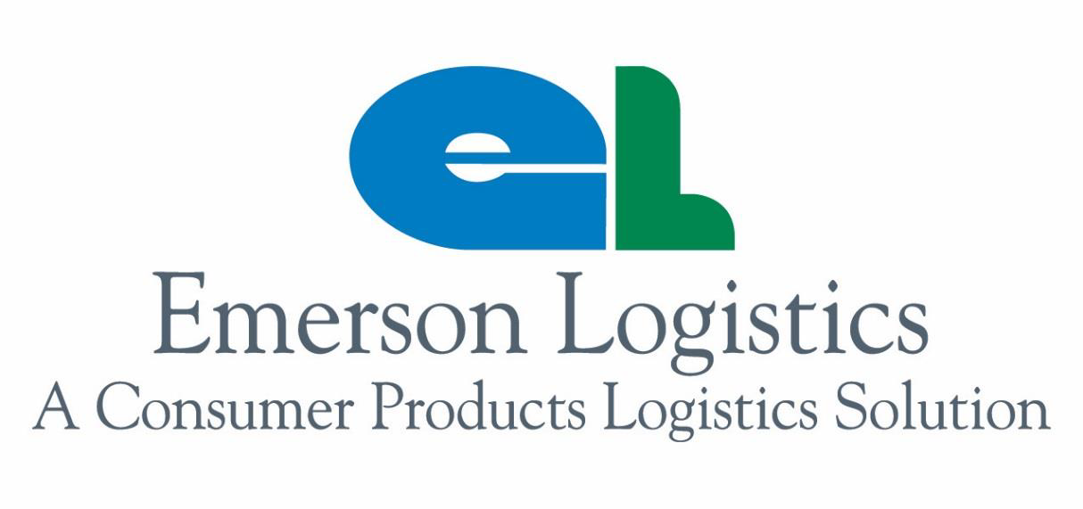
Quality, unbeatable value, and impeccable branding™
Disposable Face Mask Opportunity
04-08-20
We ship through Emerson Healthcare
James Rogers, CAE – Global Cold Chain Alliance Group
Steve Hatch – Rosemarie Products Co.

Slide 2
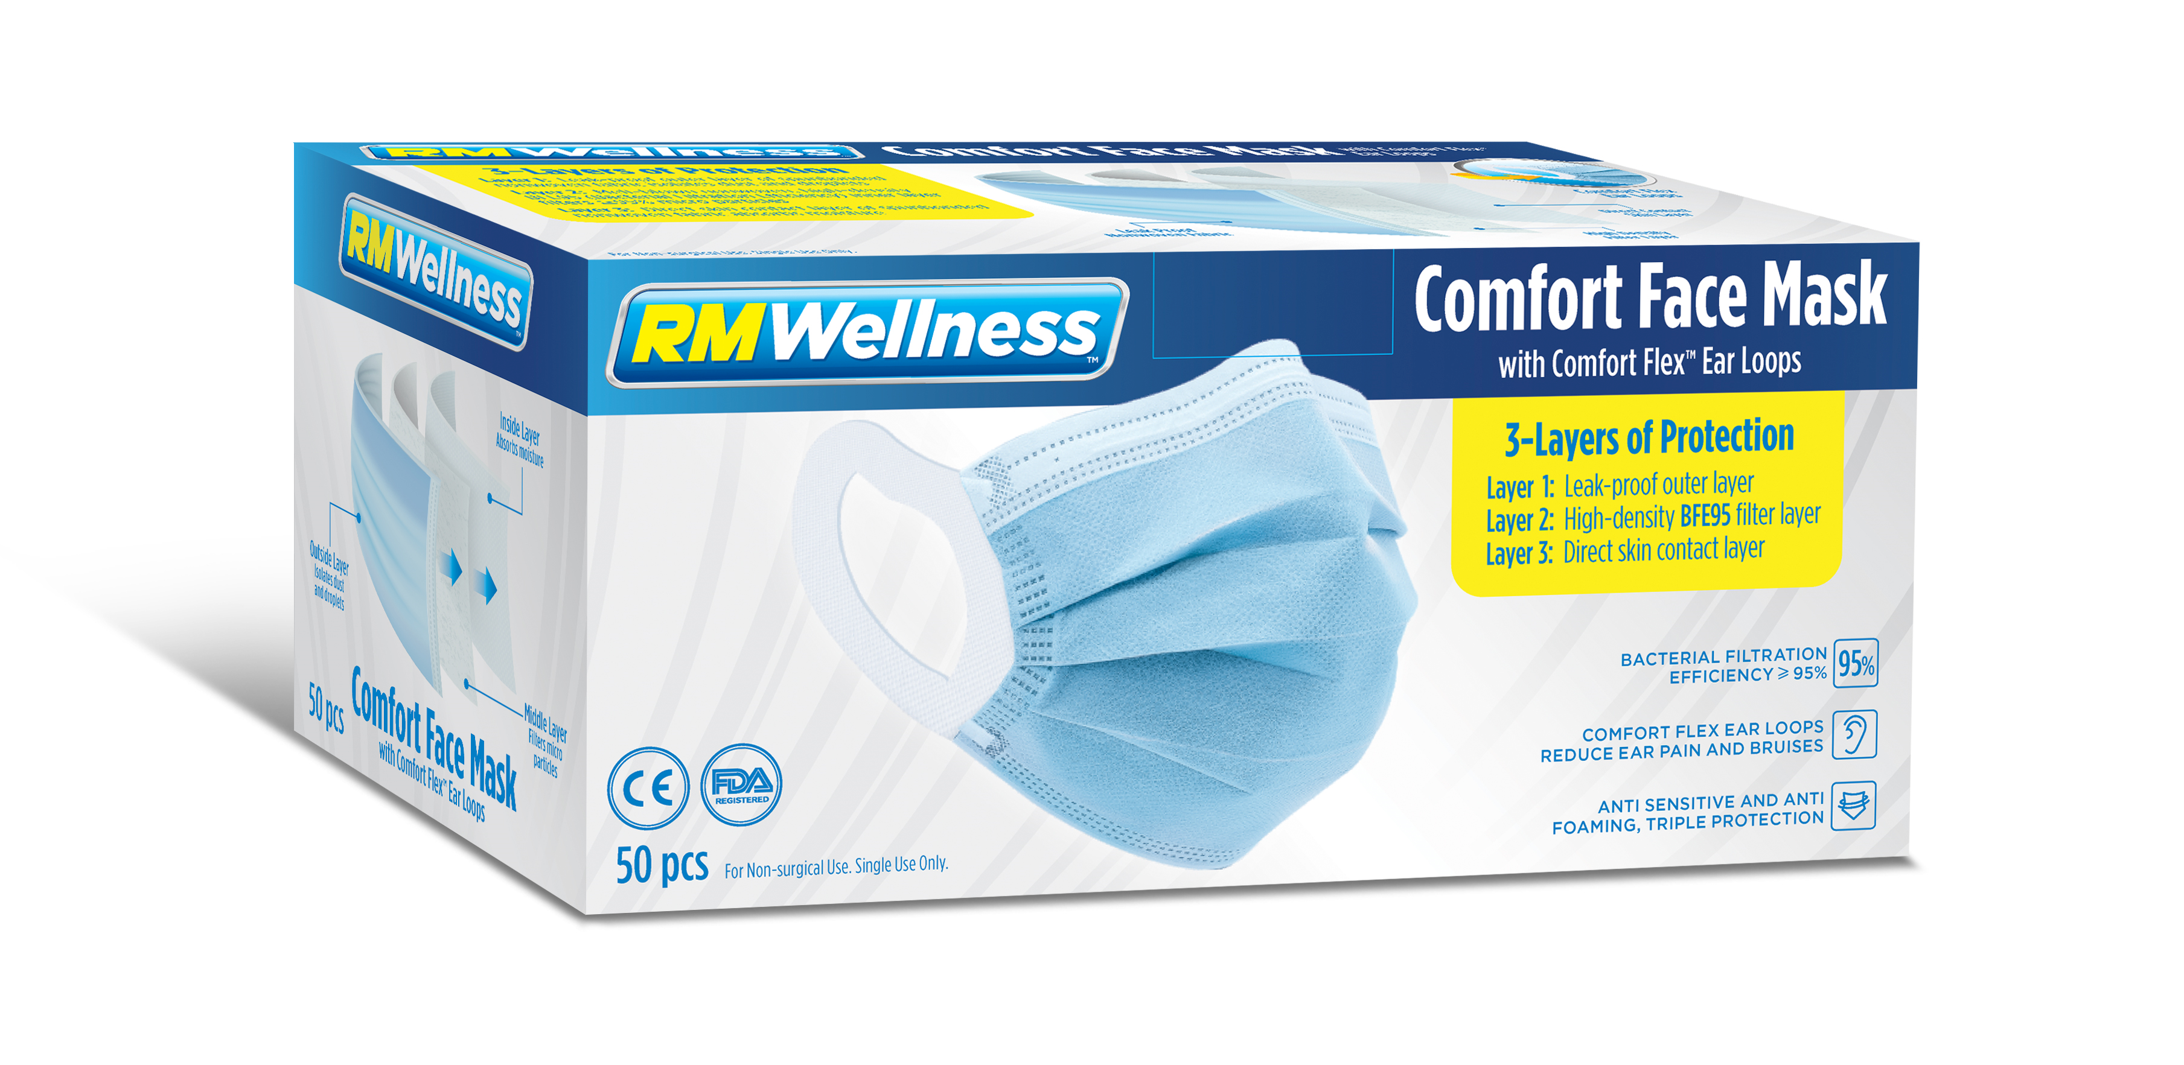
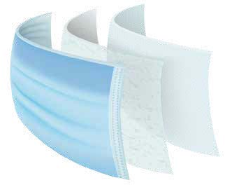
Introducing RM Wellness Comfort Face Mask
50ct Pack Size
50CT Price | Cost: $32.60
Featuring:
  3-Layers of protection:
    Layer 1: Leak-proof outer layer
    Layer 2: High-density BFE95 filter layer
    Layer 3: Direct skin contact layer
  Comfort Flex™ Ear Loops
    Reduces Ear Pain and Bruising
Cost per mask = $0.652

Slide 3
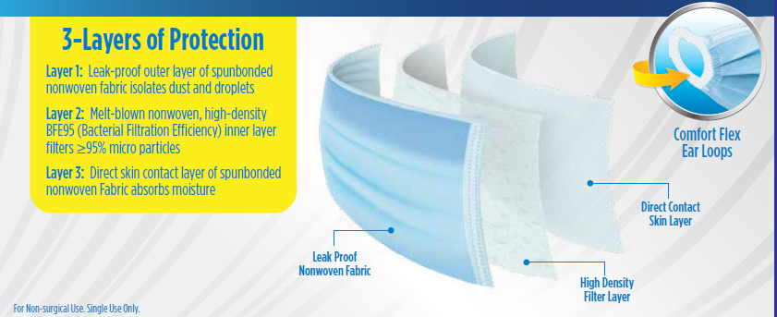
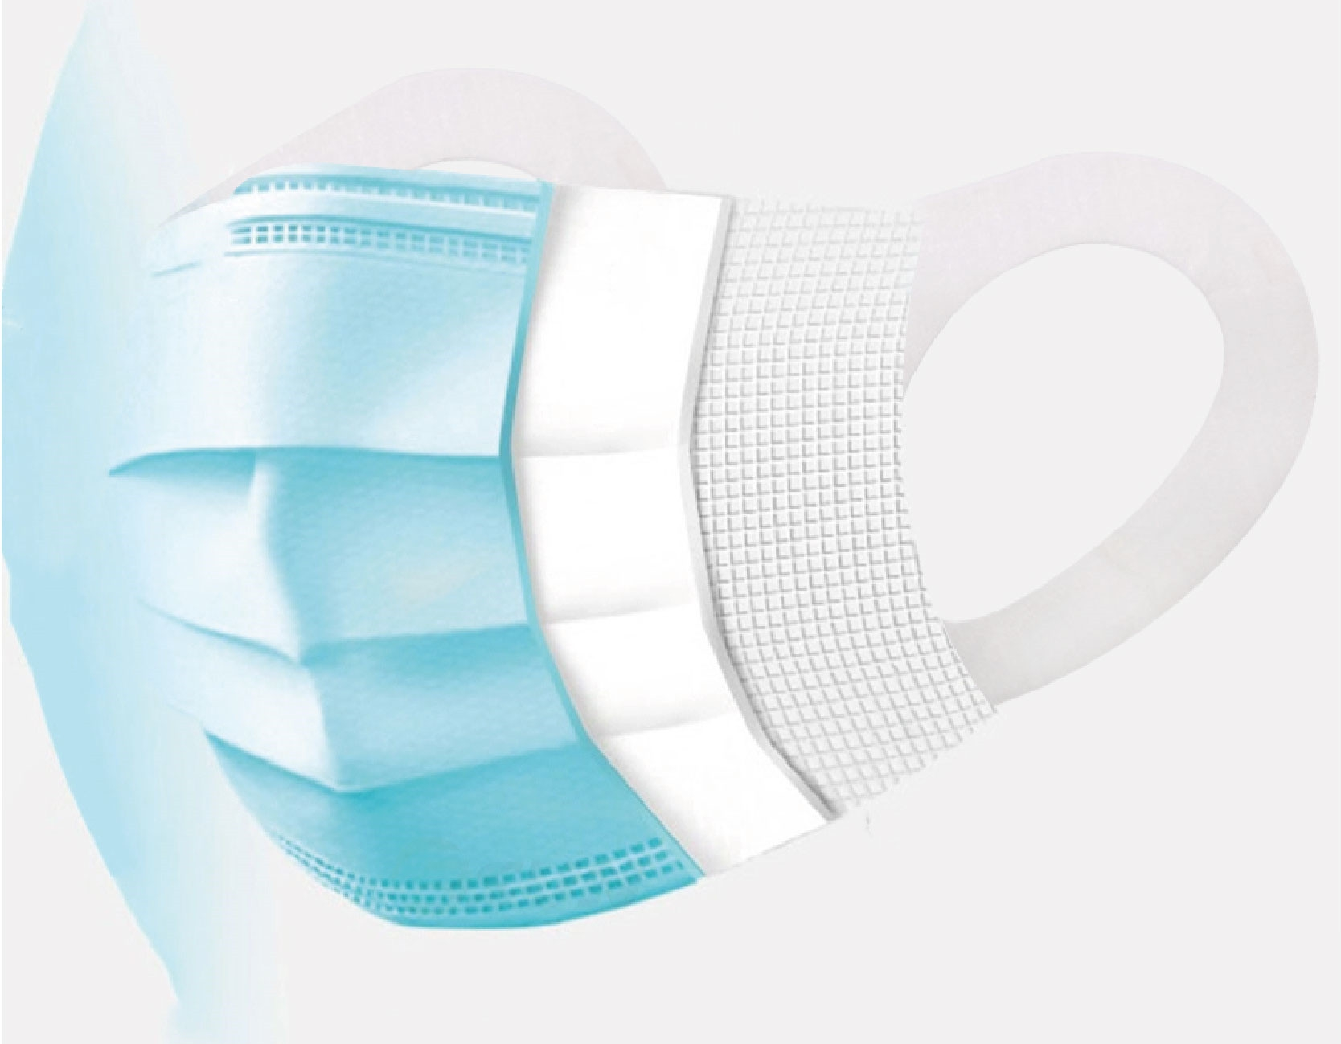
3-Layers of Protection expanded
50ct Pack Size
Price | Cost: $3.50 SRP: $6.99 Margin: 50%
3-Layers of protection

Slide 4


Specs
Brand | RM WELLNESS
Item Number | 50-71073-40
Product Description | 50CT RM WELLNESS Disposable Face Masks with Comfort Flex Ear Loops
Product Image
Product Size | 50 |  |  | Count
Product UPC | 00 8 50004 71073 9
Inner UPC | N/A
Case UPC | 20-8-50004-71073-3
Case Inner pack # inners x # pcs | 0 |  | x | 40
Case Pack (in Units) | 40
Each Dim. (Inches) (L" x D" x H") | 7.68 | x | 3.54 | x | 3.94
Inner Dim. (Inches) (L" x D" x H") | N/A | x | N/A | x | N/A
Case Dim. (Inches) (L" x D" x H") | 20.50 | x | 16.20 | x | 15.80
Case Cube (Ft) | 3.0366
Case Weight (lbs) | 23.10
Cases Ti x Hi | 5 |  | x | 3
Cases Per Pallet | 15
Pallets Double Stacked | YES
Consumer UPC Barcode
Case UPC Barcode

Slide 5
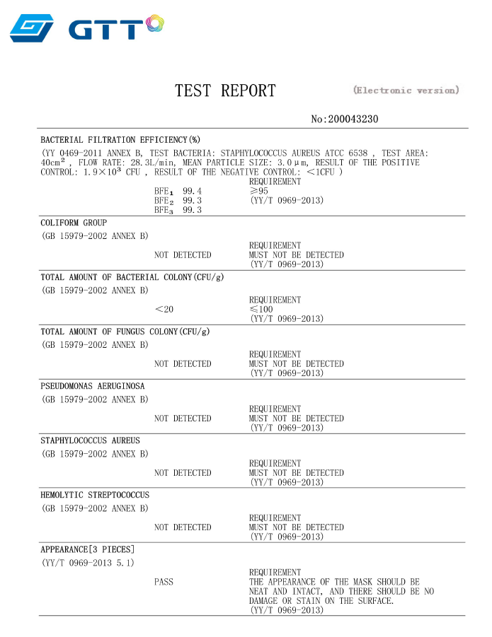
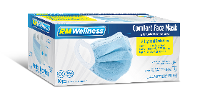
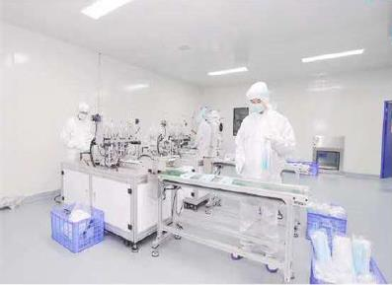
Supported by full testing and Cleanroom manufacturing

Slide 6
Appendix

Slide 7
Rosemarie’s Mission and Promise
Mission: Quality & Affordability
  Rosemarie sources and brings to market the highest quality personal care products at an incredible value.
Our Positioning: Branded opening price point (but not cheap)
  Competitively priced items, below branded competitive benchmarks
  Our products are not cheap. We are the perfect balance of quality and affordability.
Our Promise:
  High-Velocities
  Exceptional margins
  In-stock and in-full
Rosemarie – fast becoming known for the best quality/affordability ratio in the industry!

Slide 8
Forming long-term partnerships
Due to these unprecedented times. Rosemarie is looking to partner with only a select few retailers for the long-term supply of disposable face masks.
We will honor PO’s on a first-come, first-serve basis to ensure we have the production plans in place to ensure 100% on-time and in-full supply.
First order lead time:
  Airfreight – 4 weeks (depending on orders; first-come, first-served)
Ongoing order lead time
  Only 2 weeks
Request:
  Partner with Emerson/Rosemarie on forecasting to ensure we reserve your needs in production plans. 100% on-time and in-full is our goal.

Slide 9


























Our Retail partners

