Slide 1
National Emphasis Program: Warehousing and Distribution Center Operations
Jeffrey Wanko and Prentice Cline
Directorate of Enforcement Programs
August 10, 2023

Slide 2
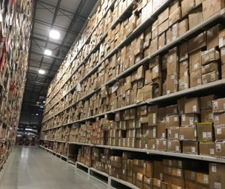
Purpose of this NEP
This NEP is intended to enhance OSHA's enforcement on:
Warehousing and distribution centers
Mail/postal processing and distribution centers
Couriers and express delivery services
Local messengers and local delivery industries
High injury rate retail establishments
This instruction provides policies and procedures for OSHA Area Offices for conducting comprehensive programmed safety inspections of establishments within the designated NAICS listed in this NEP.

Slide 3
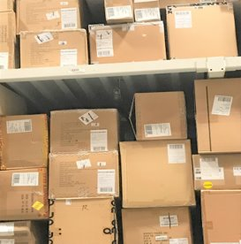
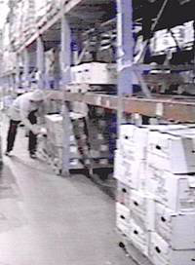
Purpose of this NEP
Improve worker safety by reducing exposure to common hazards in the targeted industries such as:
powered industrial vehicle operations
material handling/storage
walking-working surfaces
means of egress
fire protection
Improve worker health outcomes by reducing exposure to heat and ergonomic hazards. Both will be considered during all NEP inspections, and addressed when hazards are identified.

Slide 4
Hazards and Solutions
Warehouse workers face many hazards, but proper design, planning and training can keep them safe.
This site provides information on the various hazards and the solutions to those hazards. (link placed in chat)
Warehousing - Hazards and Solutions | Occupational Safety and Health Administration (osha.gov)

Slide 5
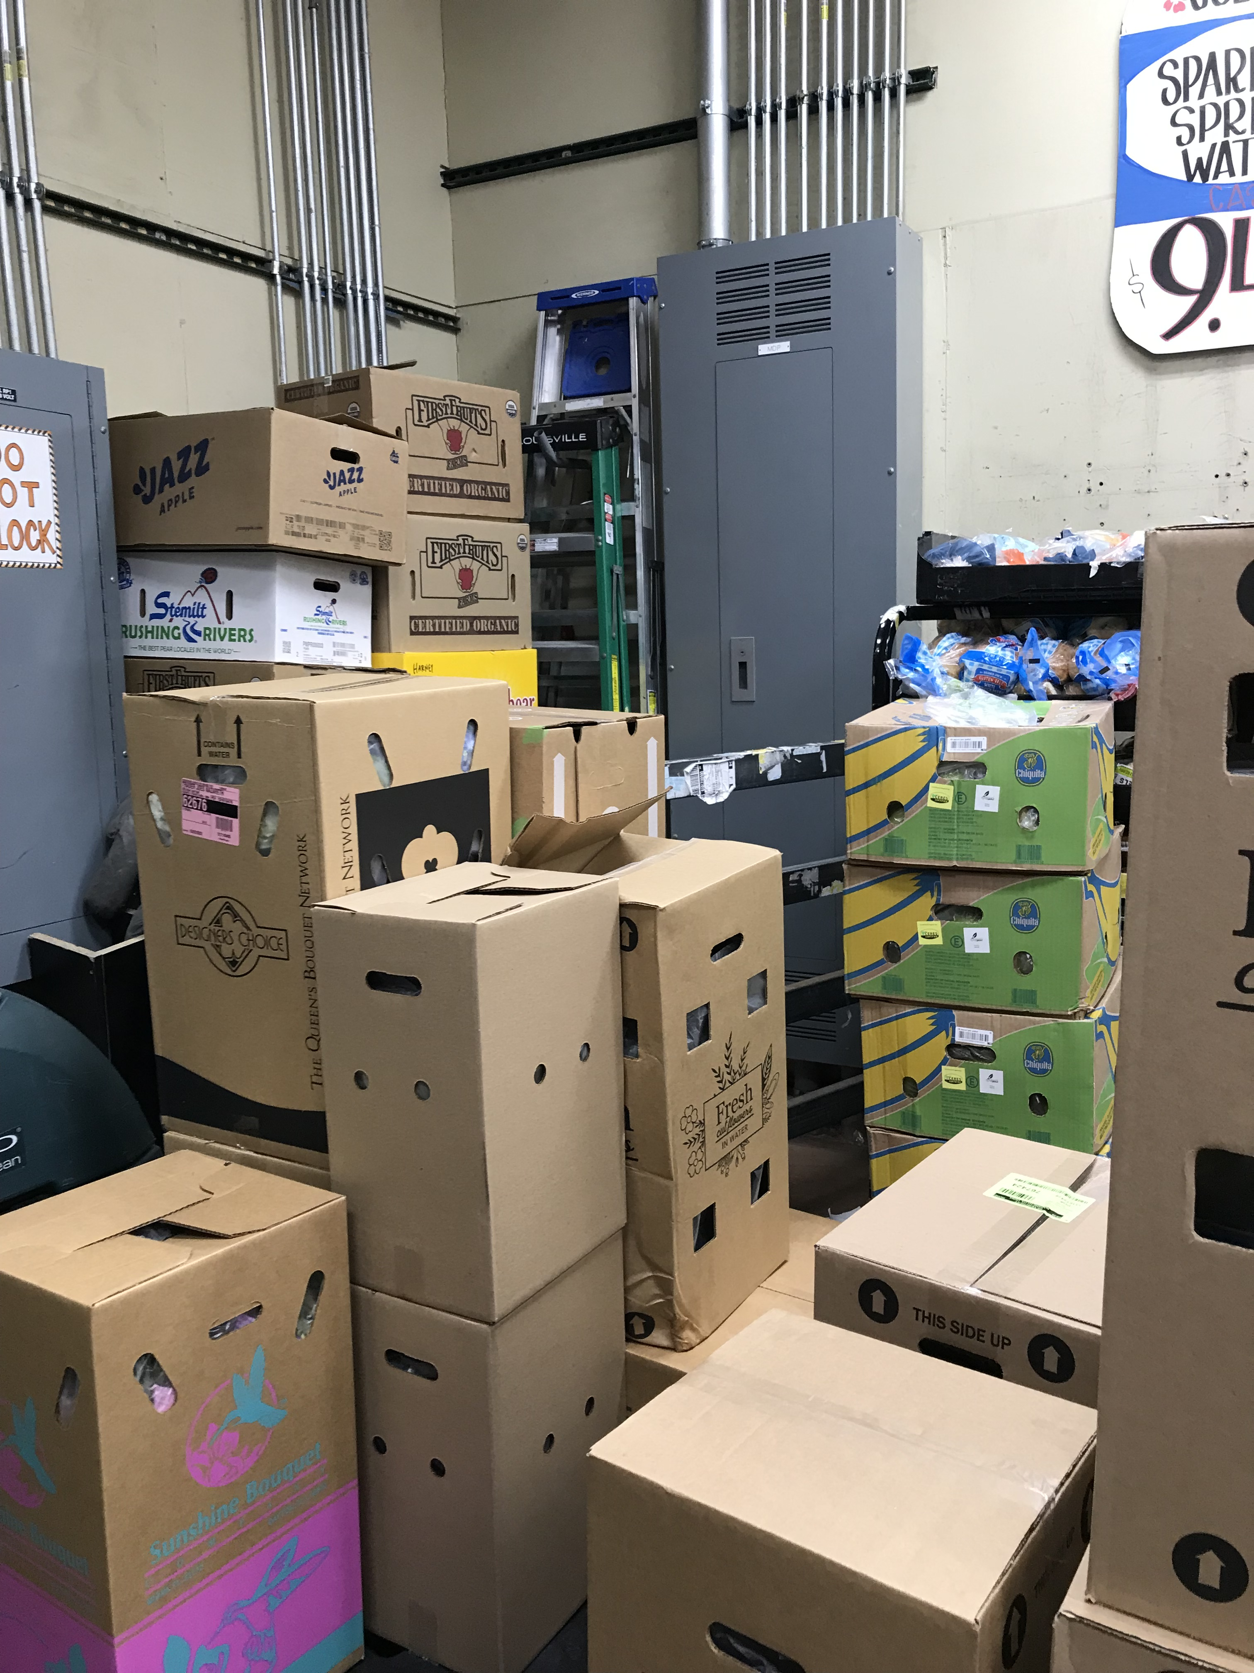
Commonly cited standards for this industry
1910 Subpart D | Walking-working surfaces
1910 Subpart E | Exit routes & Emergency Planning
1910 Subpart F | Manlifts
1910 Subpart G | Occupational Health and Environmental Control
1910 Subpart H | Hazardous Materials
1910 Subpart I | Personal Protective Equipment
1910 Subpart J | General Environmental Controls
1910 Subpart K | Medical and First Aid
1910 Subpart L | Fire Protection
1910 Subpart N | Materials Handling and Storage
1910 Subpart O | Machinery and Machine Guarding
1910 Subpart P | Hand and Portable Powered Tools & other Hand-Held Equipment
1910 Subpart S | Electrical
1910 Subpart Z | Toxic and Hazardous Substances

Slide 6
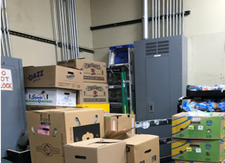

NAICS Codes Targeted by this NEP
Inspections of warehousing and distribution centers, mail processing and distribution centers, couriers and express delivery services, and local messengers and local delivery industries under this NEP are comprehensive safety inspections.
Inspections under this NEP of high injury rate retail establishments will be partial inspections concerning the storage and loading areas unless OSHA expands the scope of the inspection when there is evidence that violative conditions may be found in other areas of that establishment.

Slide 7
NAICS Codes Targeted by this NEP
Table 2: Covered Industries
Table 3: High Injury Rate Retail Establishments
NAICS CODES | ESTABLISHMENTS
491110 | Postal Service (Processing and Distribution Centers only)
492110 | Couriers and Express Delivery Services
492210 | Local Messengers and Local Delivery
493110 | General Warehousing and Storage
493120 | Refrigerated Warehousing and Storage
493130 | Farm Product Warehousing and Storage
493190 | Other Warehousing and Storage
NAICS CODES | HIGH INJURY RATE RETAIL ESTABLISHMENTS
444110 | Home Centers
444130 | Hardware Stores
444190 | Other Building Material Dealers
445110 | Supermarkets and other grocery stores
452311 | Warehouse Clubs and Supercenters

Slide 8
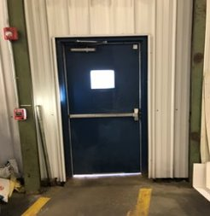
Inspections
This NEP covers both programmed and unprogrammed safety inspections.
Inspections based upon fatalities/catastrophes, complaints, or referrals related to establishments in the NAICS codes (table 2 establishments only) covered under this NEP shall be expanded to comprehensive safety inspections in accordance with this Instruction.
Inspections under this NEP:
will not include postal or package transportation/delivery to residences and businesses.
may be combined with other programmed and unprogrammed inspections.

Slide 9
Outreach Period
There is a 90-day outreach program to covered industries, prior to conducting inspections under this NEP.
The covered industries are included in Tables 2 and 3 of the NEP.
Inspections under this NEP may begin on or after October 13, 2023.
The NEP expires three years from the effective date of July 13, 2023.

Slide 10

Resources
Warehousing - Overview | Occupational Safety and Health Administration (osha.gov)
eTools : Grocery Warehousing - Storage | Occupational Safety and Health Administration (osha.gov)

